Slide 1
Open Data and Knowledge Graphs
Data Science MsC
BiciMAP: Analyzing BiciMAD Data
Francisco de Borja Lozano del Moral
Samuel Salgueiro Sanchez
Sheyla Leyva Sánchez
Mariajose Franco Orozco

Slide 2

data
Bicycle data from the BiciMAD system in Madrid
License
Allowed Uses:
The data can be reused for commercial and non-commercial purposes.
Data can be shared or distributed.
Restrictions:
The reuser must not distort the data or present false information.
The information must always be kept accurate and updated.
Usage of the data should not harm EMT's image or associate EMT with illegal activities.
IA generated
Powered by EMT de Madrid

Slide 3
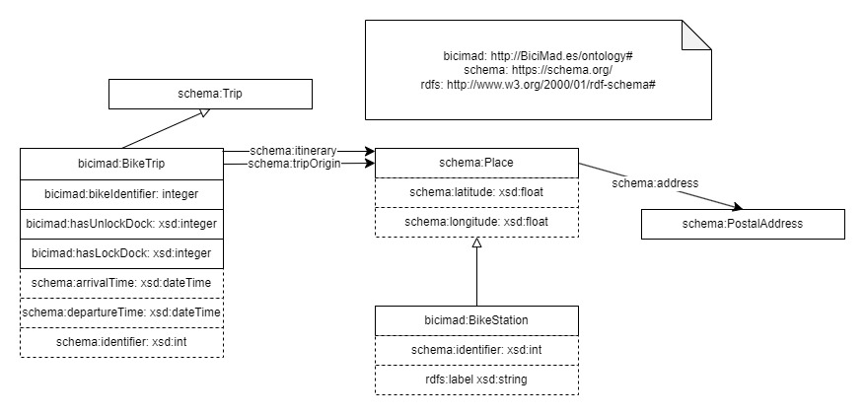

Ontology
Taken from https://protege.stanford.edu/download/protege/4.0/installanywhere/
Powered by EMT de Madrid

Slide 4


cleaning and preparation
Initial Dataset
01.
Obtaining coordinates
{'type': 'Point', 'coordinates': [-3.6956178, 40.4132798]}
geolocation_unlock
geolocation_lock
start_latitude
start_longitude
end_latitude
end_longitude
OpenRefine
Powered by EMT de Madrid

Slide 5
cleaning and preparation
02.
Dividing datasets
Trips Dataset
Station Dataset
Free Places Dataset
Powered by EMT de Madrid

Slide 6

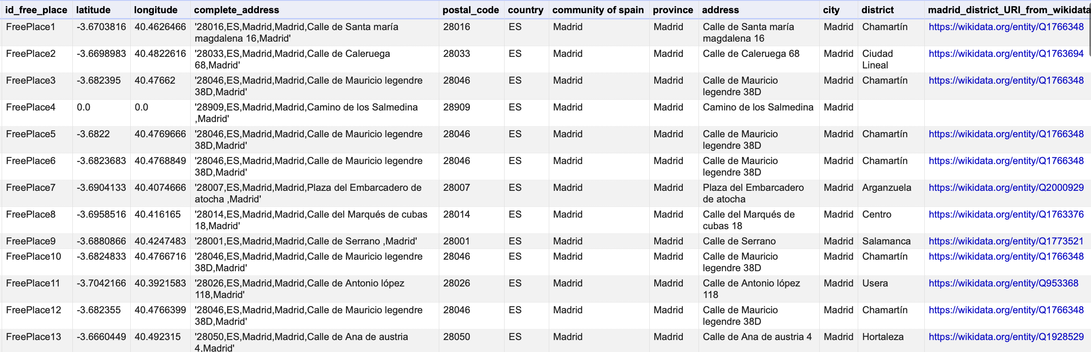
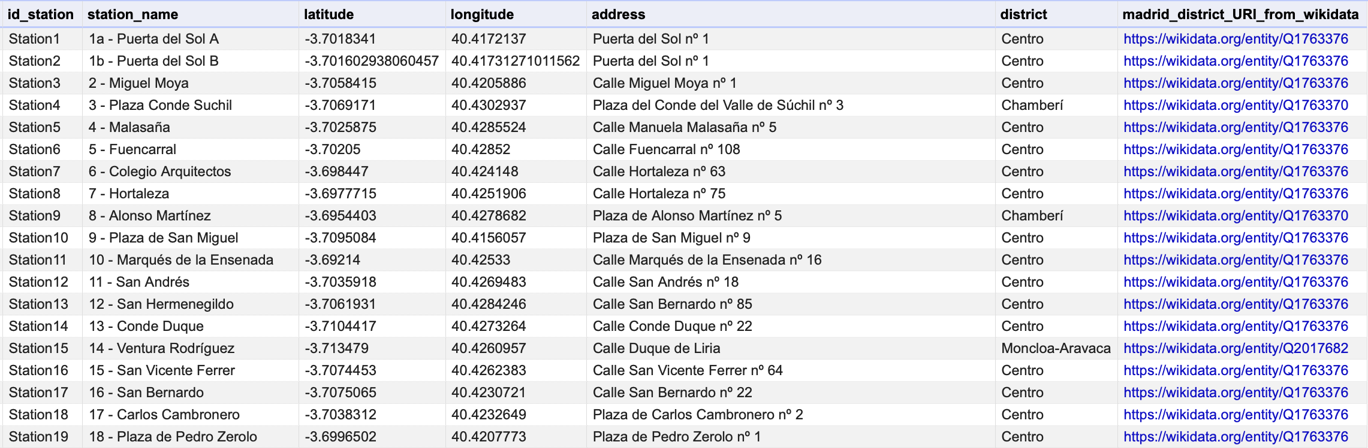
linking data with wikidata
jh
Dataset
free places
Dataset
stations
Powered by EMT de Madrid

Slide 7
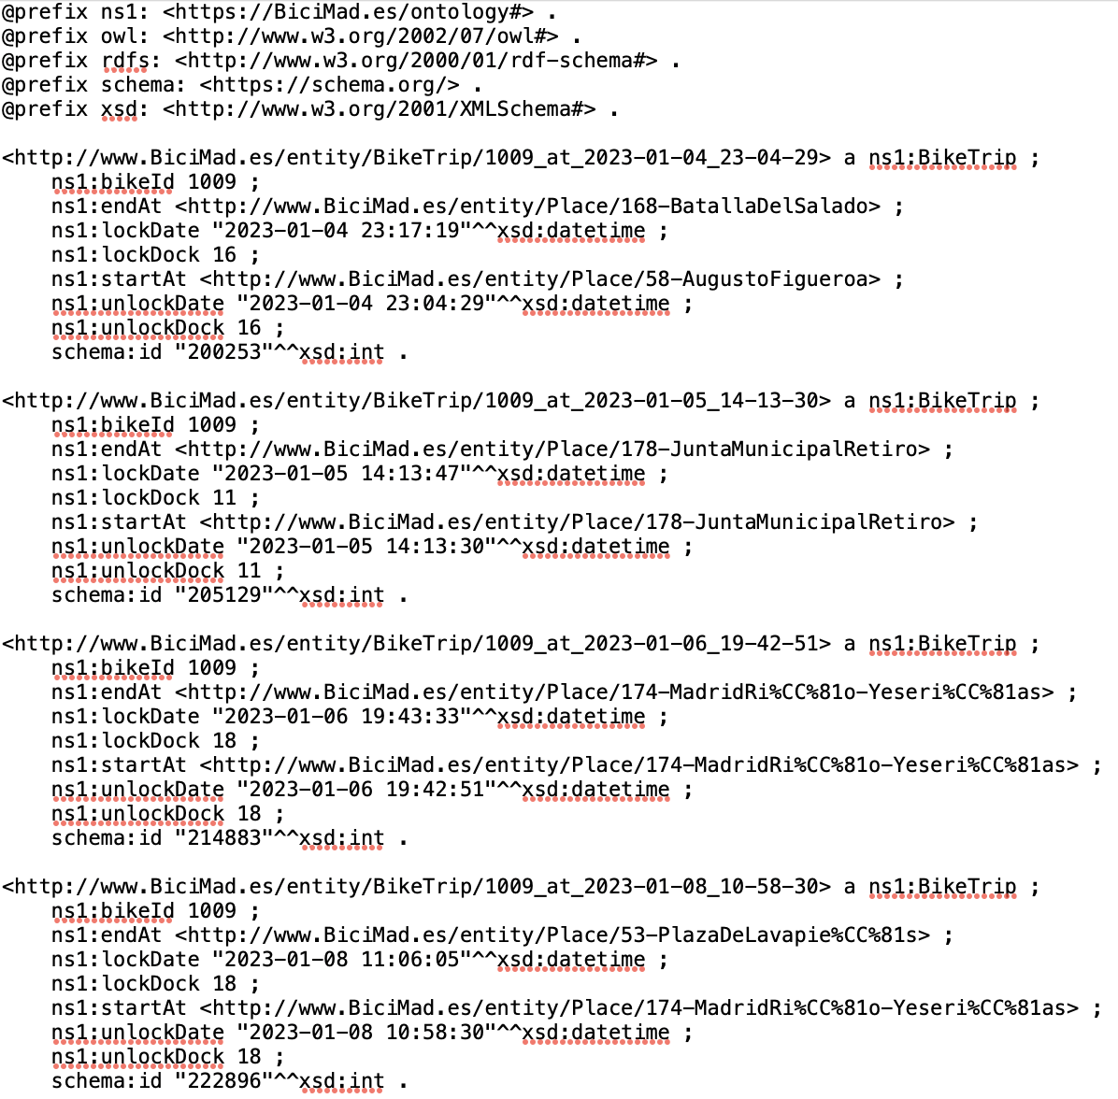
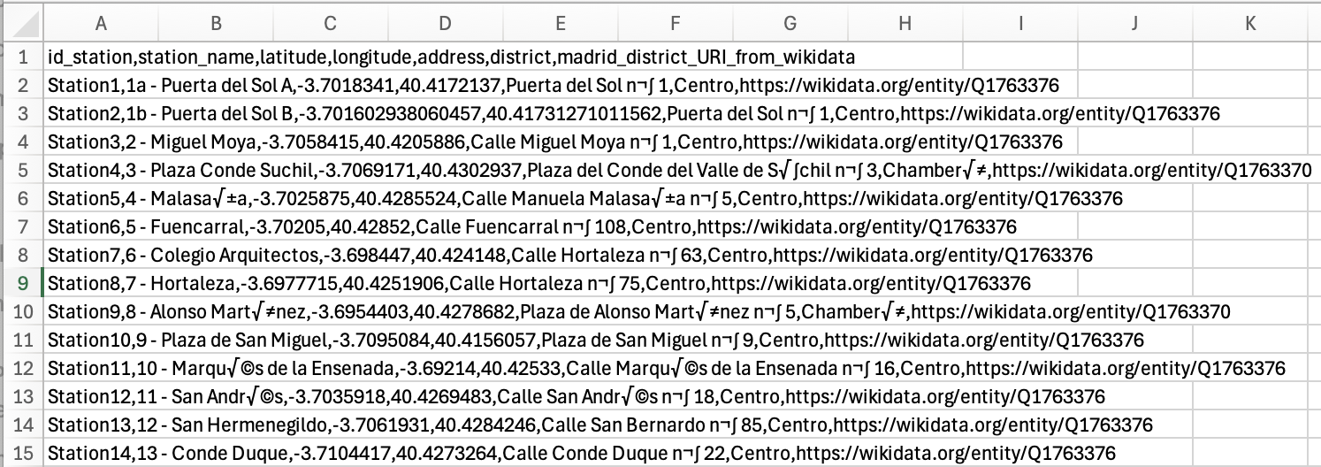

transformation using RML mappings
RDF
csv
Taken from https://github.com/morph-kgc/morph-kgc
Powered by EMT de Madrid

Slide 8
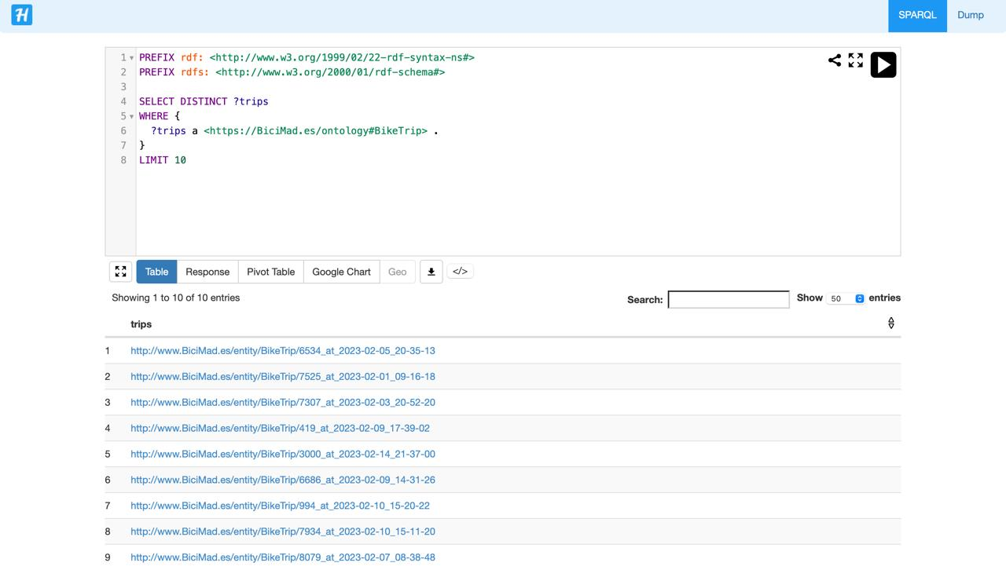
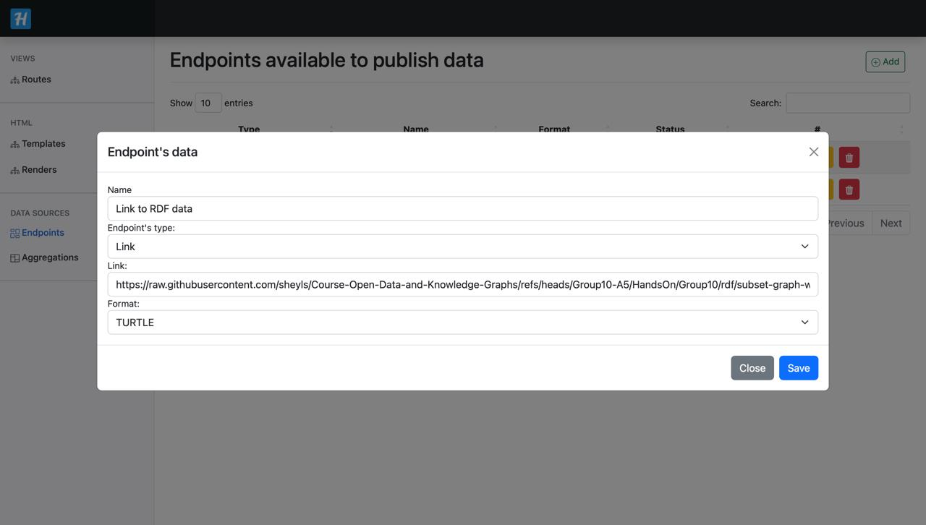
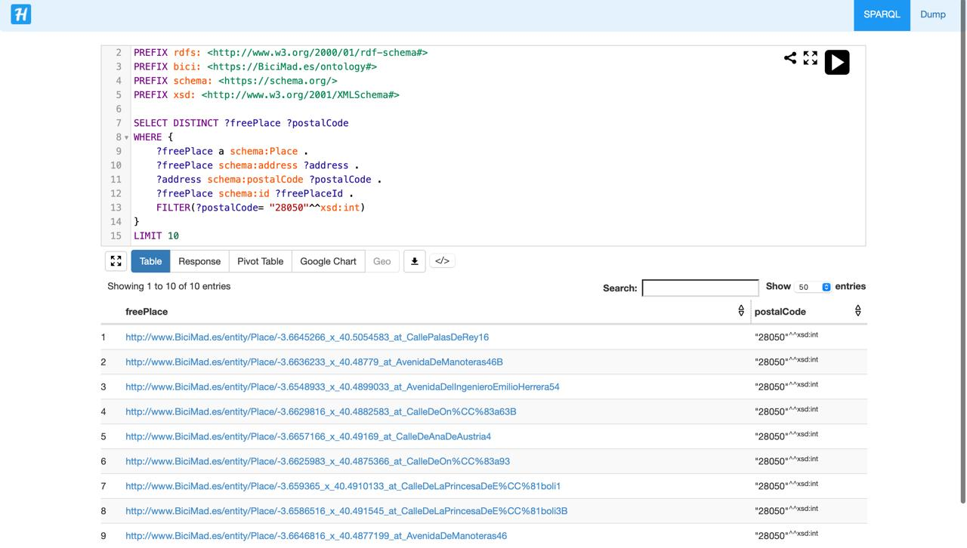
publication of linked data
HELIO
Powered by EMT de Madrid

Slide 9
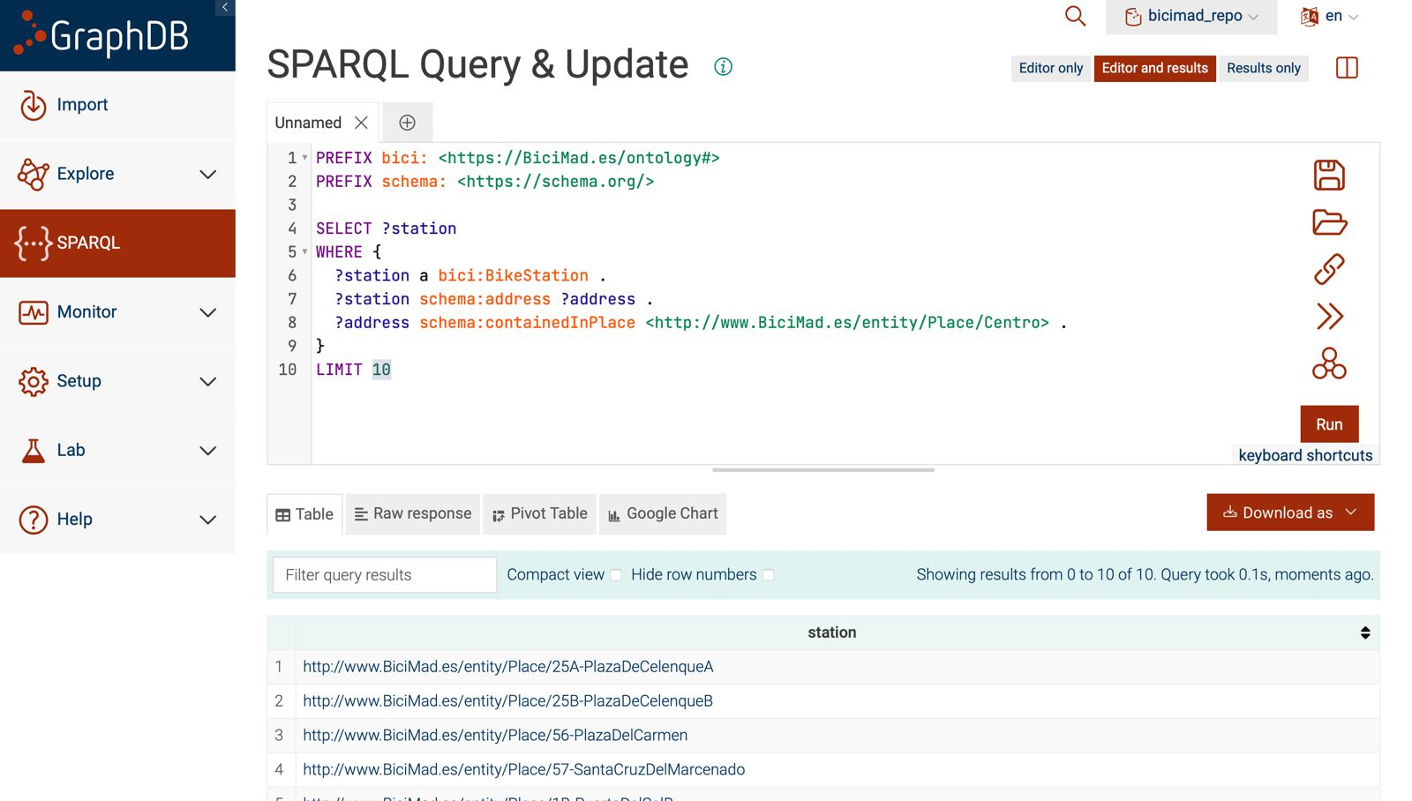
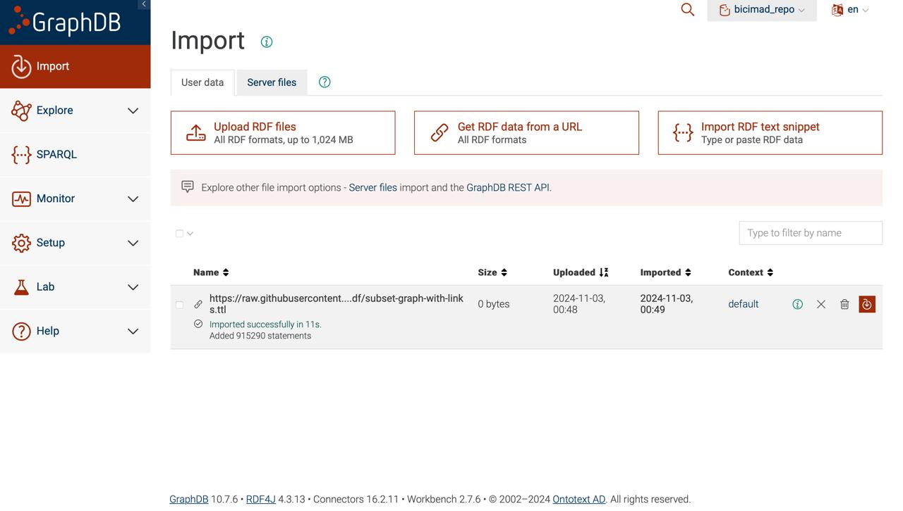
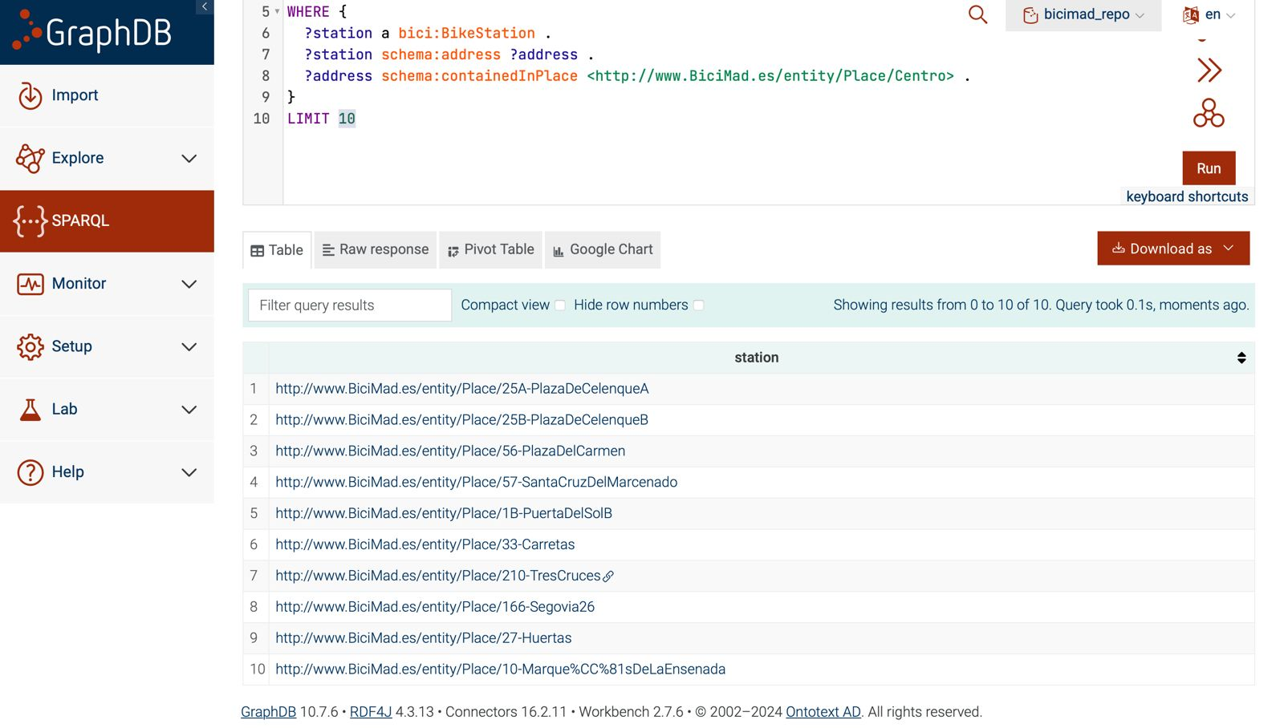
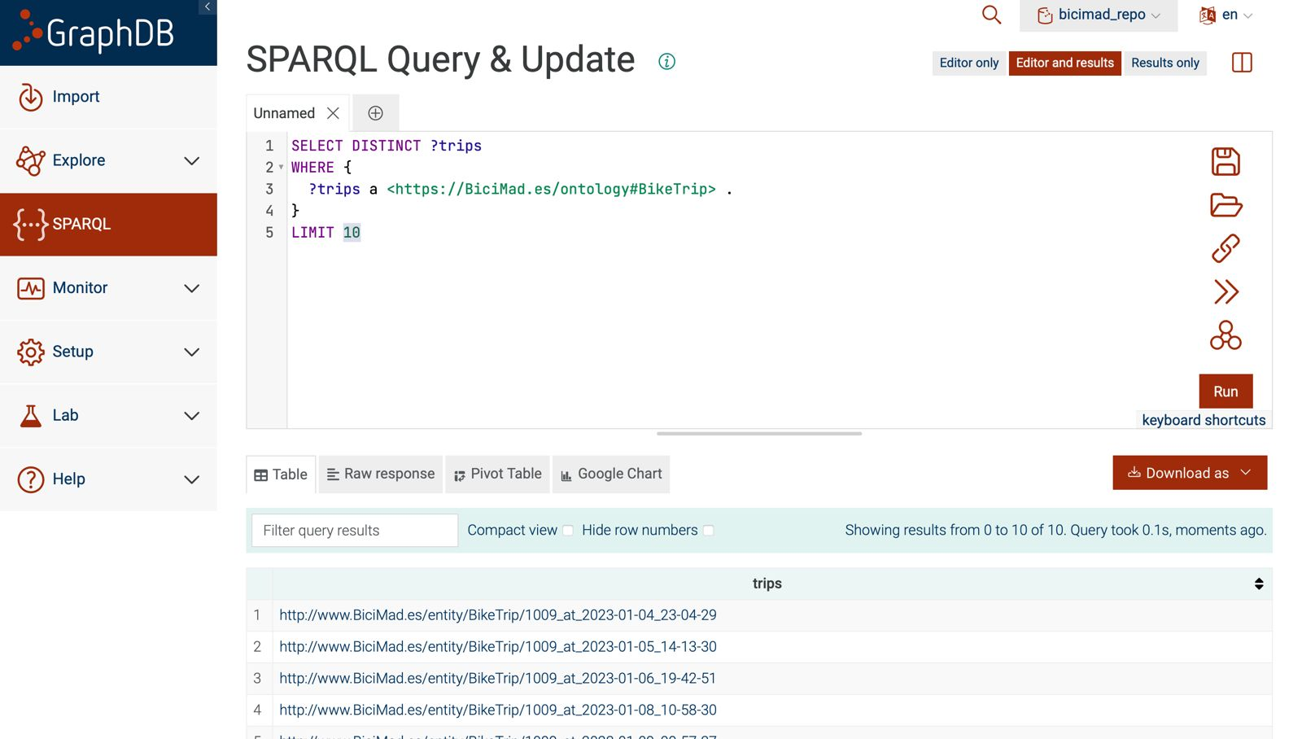
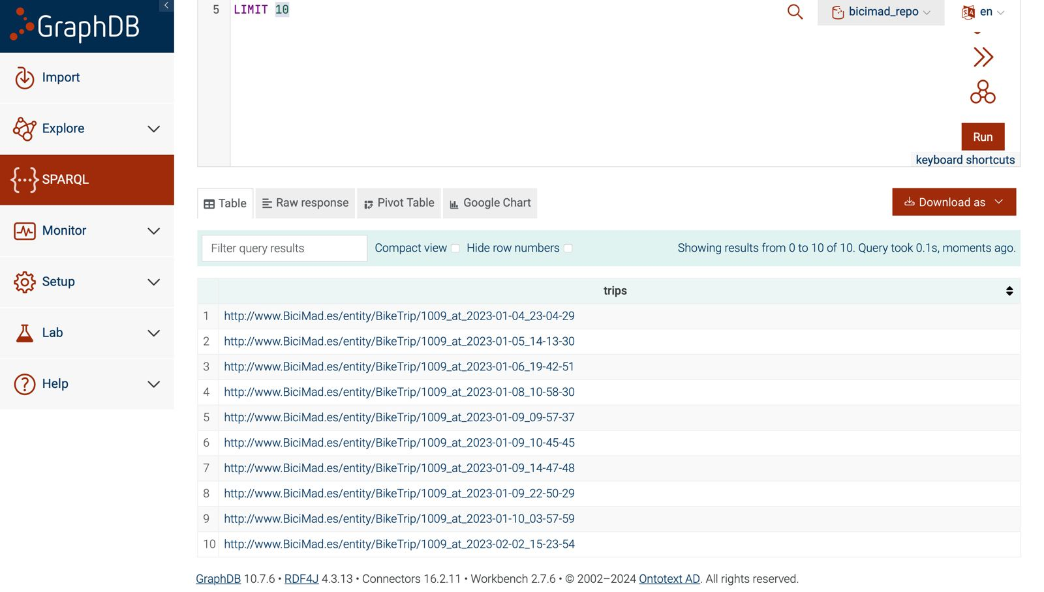
publication of linked data
GraphDB
Powered by EMT de Madrid

Slide 10
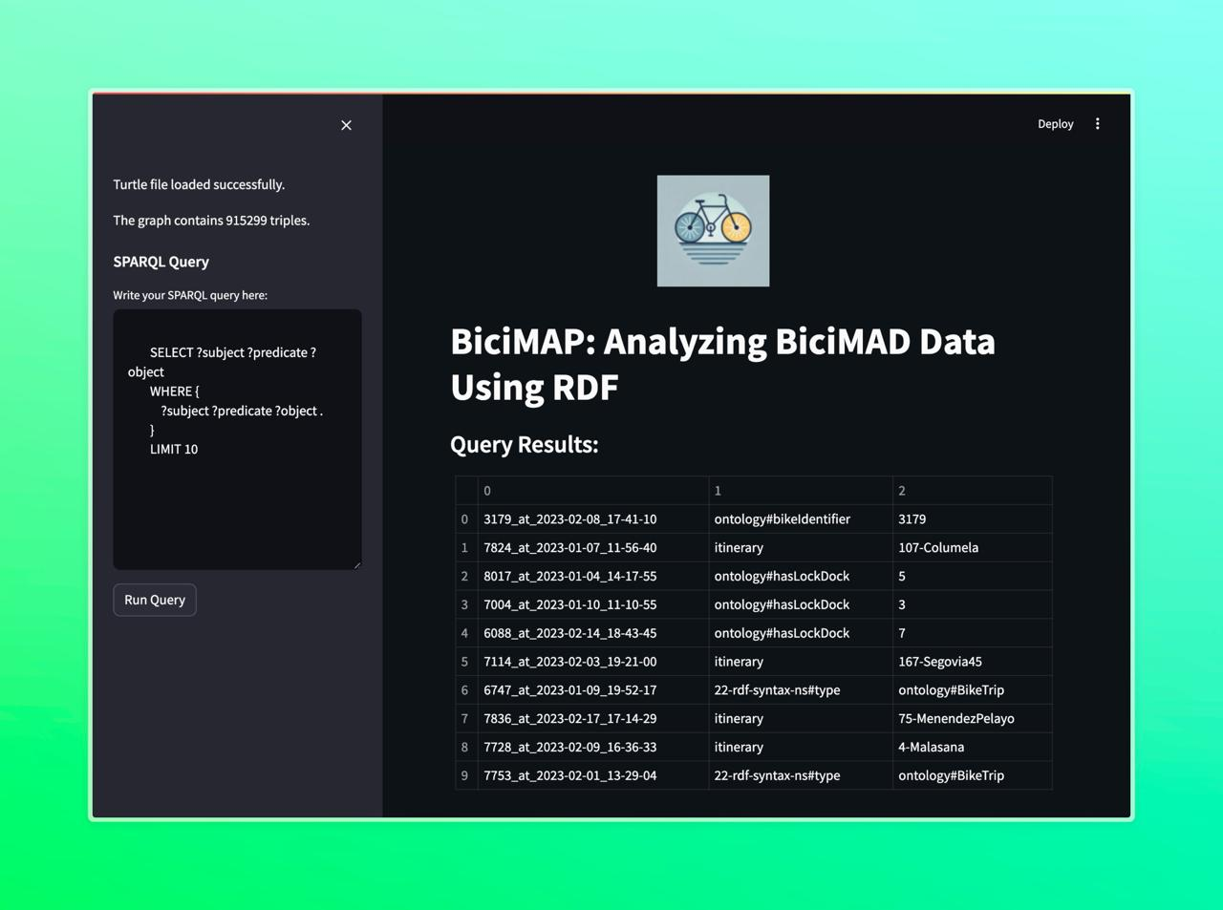
app
Powered by EMT de Madrid

Slide 11
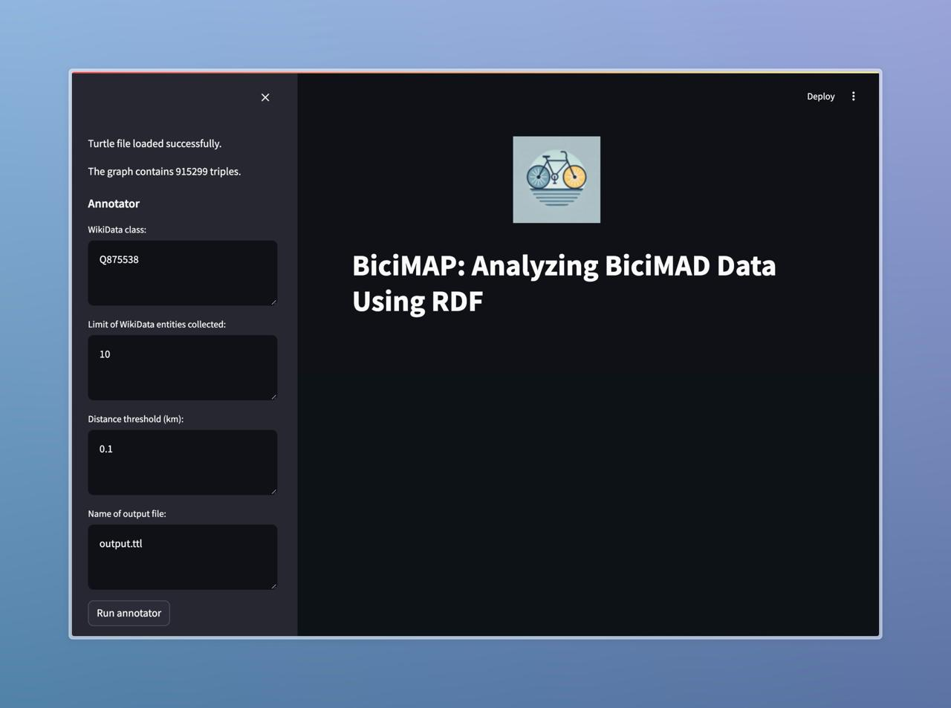
app
Powered by EMT de Madrid

Slide 12

Powered by EMT de Madrid

